Slide 1
新世代微創醫療器材 營運計畫
陳治豪 MD, phD
馬偕紀念醫院 胸腔外科 資深主治醫師
馬偕醫學院 醫學系 助理教授

Slide 2
報告內容摘要
市場規模
相關趨勢解析
核心能力與關注焦點
進程表

Slide 3
報告內容摘要
市場規模
相關趨勢解析
核心能力與關注焦點
進程表

Slide 4
預期2018以後medical device 市場會超過藥品 2016 年將達到415B http://www.fiercemedicaldevices.com/tags/medical-device-market

Slide 5
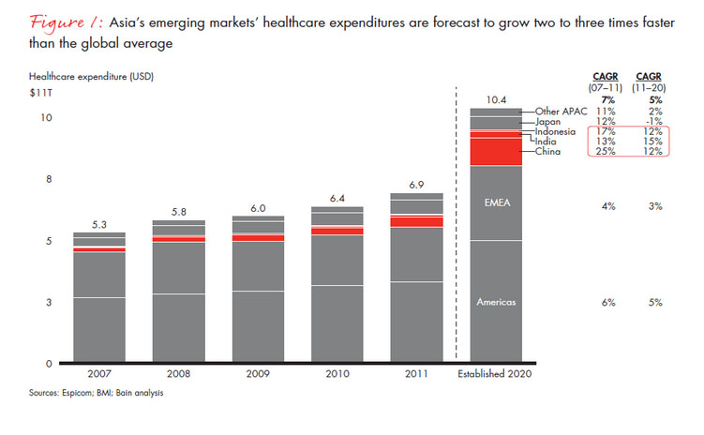
全球主要區域之醫材市場

Slide 6
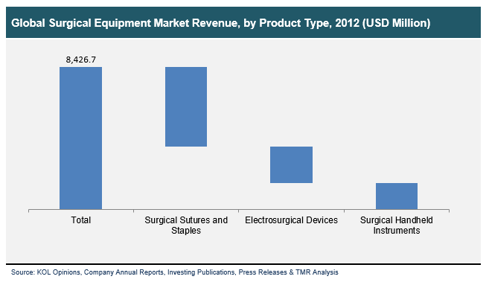
Now back to surgical equipment
Market in Surgical Equipment
Surgical sutures and staples
Suture
staples
Surgical handheld instruments
Scarpels
Forceps
Retractors
Electrosurgical devices

Slide 7
Will Expand to 12.1 B by 2020

Slide 8
KMX patent analytical tool patent map

Slide 9
報告內容摘要
市場規模
相關趨勢解析
核心能力與關注焦點
進程表

Slide 10
關於微創手術與器材
An overview of MIS !
Minimally Invasive Surgery (MIS ) 微創手術
Or termed as “MIP”, meaning miniamlly invasive procedure
Let’s see the status of MIS in the US at the present time.

Slide 11
Minimally Invasive Surgery

Slide 12
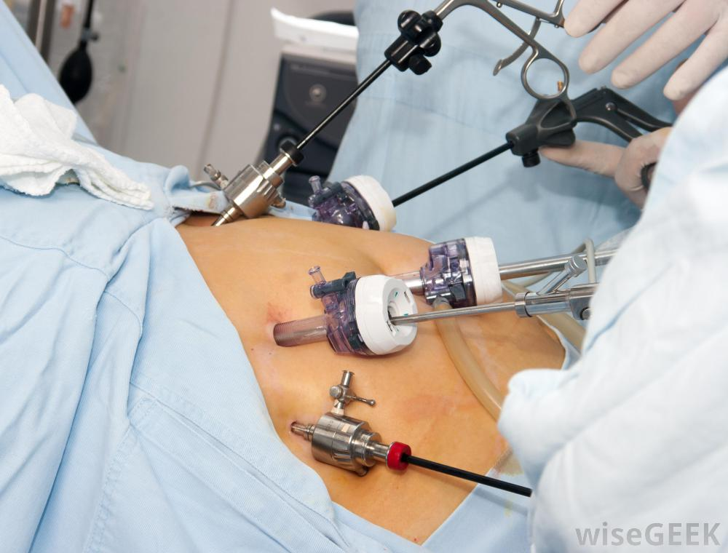
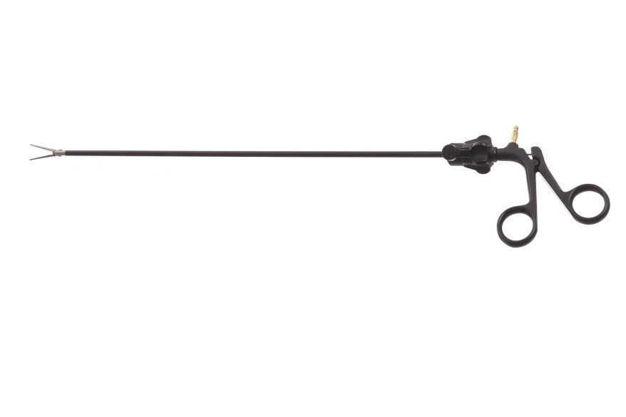
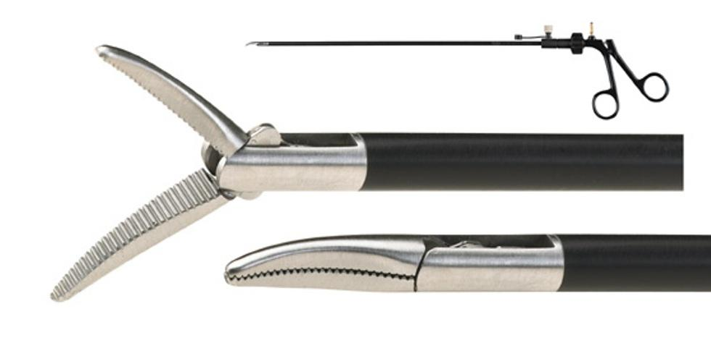
Product Description
Surgical instrument
Conventional type, rigid and straight form
No problem in conventional multiportal endoscopic surgery

Slide 13
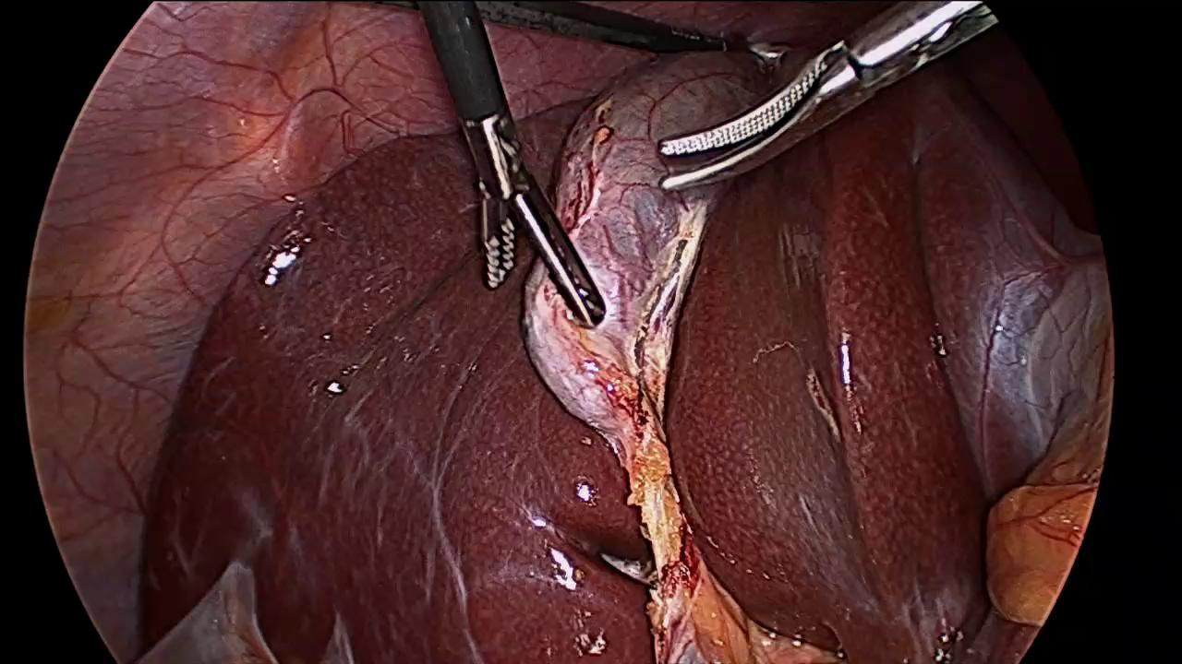
Product Description Multiportal surgery is easier as shown below. Instruments of Long, straight and rigid form are fine.

Slide 14
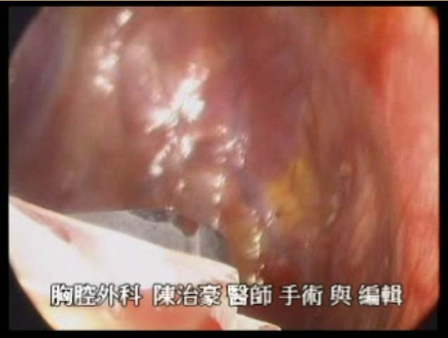
Product Description When confined within an uniportal approach, conventional instrument is a problem for manipulation. Different tools is required to perform such procedure. Therefore, we…….

Slide 15
Percentage of MIS in certain procedure

Slide 16
The benefits of MIP

Slide 17
SIES : 未來趨勢

Slide 18
The Market of MIP is under-estimated and is till growing!
The % of MIP and amount of MIP will increase quickly.
Among all MIP, SIES and NOTES will play major roles.
All tools in MIP is our focus.
Endoscope ( ENFE product )
Instruments
All Innovative tools in Minimally Invasive Procedure is our focus !

Slide 19
Development index in Surgical Instrument: 15.8% much better in medication (less than 1%)

Slide 20
報告內容摘要
市場規模
相關趨勢解析
核心能力與關注焦點
進程表

Slide 21
初始團隊核心能力
核心能力 –醫療專業背景, 醫材開發, 金屬加工與精密機械
陳治豪 : (MD, phD) as the team leader
臨床外科醫師
全世界最早施行單孔胸腔鏡手術的醫師之一
對臨床使用工具有明確的認知與務實的需求
李X弘 : ( RD ) as RD leader
具備業界醫材開發經驗, 機械電子技術背景出身, 善於精密加工
簡X豪 : (RD ), phD
有開發運動用醫材與申請510K經驗, 也參與過FDA查廠的經驗
李X銘 : (RD)
有醫用內視鏡開發經驗, 待過相關業界
王X全 : (RD)
有醫材開發研究經驗
戴X穎 : (RD, marketing, regulation ) , phD
運動醫療產品開發經驗
法規專才

Slide 22
The Market of MIP is under-estimated and is till growing!
廣泛性的內視鏡手術與相關工具皆為關注的開發焦點
Our focus :
All tools in Minimally Invasive Surgery

Slide 23
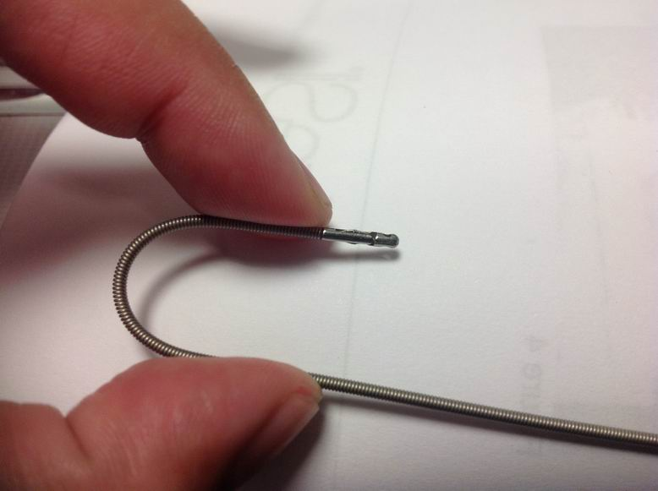
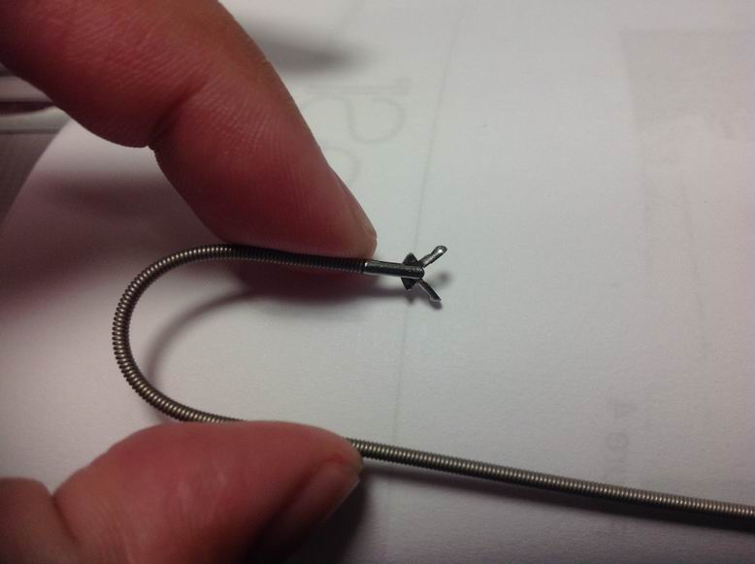
Description of the initial products We designed such device.
Surgical instrument
Metal Materials, multi-joints, a more reliable design
Better than Coviden instrument
Innovative type, could be steerable, anti-twist rigidity
Steerable surgical instrument, esp. useful in SIES and NOTEs.

Slide 24
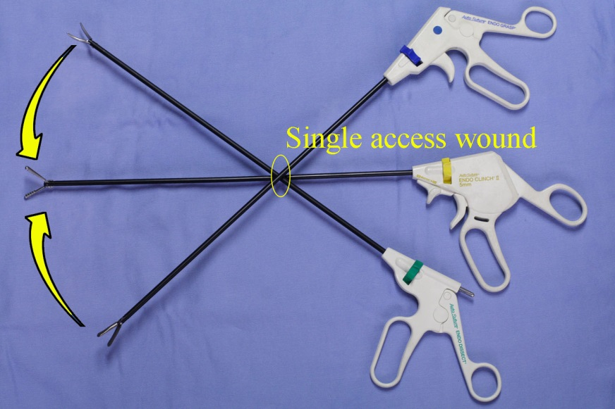
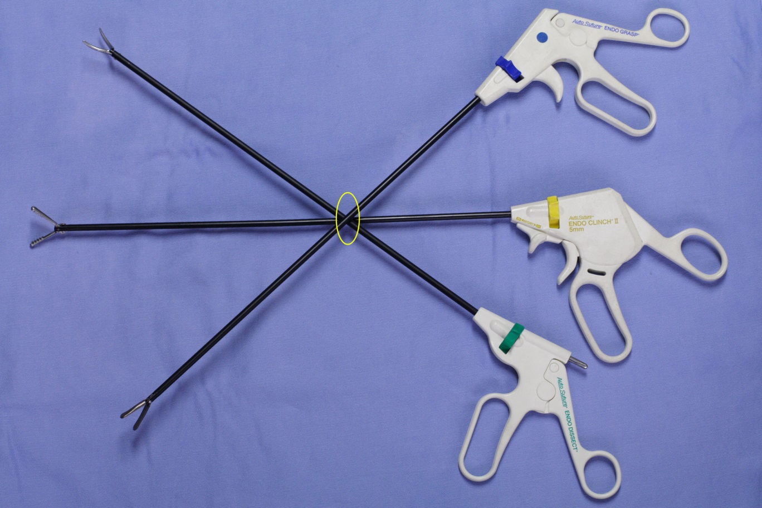
Specialized for SIES and future NOTES

Slide 25
報告內容摘要
市場規模調查, 相關趨勢解析, 全球高階經理人之市場調查
核心能力與關注焦點
進程表

Slide 26
Where are we now ?
團隊的投資均已到位即將正式開始運作
Thanks for your kindly attention.
Presented by 陳治豪 醫師

